Slide 1
Advanced Algorithm Analysis

Slide 2
Today’s Lecture
Algorithm
Use of Algorithms
Algorithm Designing
Algorithm Analysis
Experimental proof of efficiency of an Algorithm
Mathematical Approach

Slide 3
Algorithm
Problem Statement
  Relationship b/w input and output
Algorithm
  Procedure to achieve the relationship
Definition
  A sequence of computational steps which transform the input to output
Instance
  The input needed to compute solution
Correct Algorithm
  for every input it halts with correct output
Instructor: Muhammad Umair

Slide 4
Use of Algorithms
Human Genome Project
Internet
Electronic Commerce
Manufacturing & Commercial Setting
Communication Links (Graph)
Matrix Multiplication
Proof of equation

Slide 5
Algorithms Design
Design
  Data Structure
  Techniques
Hard Problems

Slide 6
Algorithms Analysis
Efficiency
  Speed
  Memory
Bench Marks

Slide 7
Running Time to Sort Array of 2000 Integers
Type of Computer | Time (sec)
Home Computer | 51.915
Desktop Computer | 11.508
Minicomputer | 2.382
Mainframe Computer | 0.431
Supercomputer | 0.087

Slide 8
Comparison
Array Size | Home Comp | Desktop Comp
125 | 12.5 | 2.8
250 | 49.3 | 11.0
500 | 195.8 | 43.4
1000 | 780.3 | 172.9
2000 | 3114.9 | 690.5

Slide 9
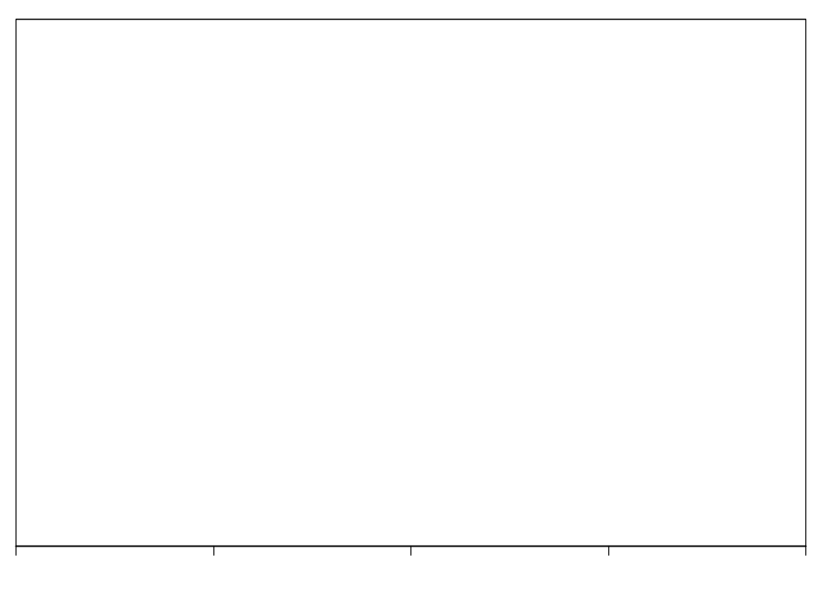
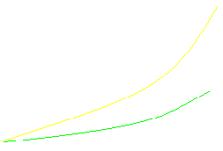
Graphical Comparison
3000
f1(n) = 0.0007772 n2 + 0.00305 n + 0.001
f2(n) = 0.0001724 n2 + 0.00040 n + 0.100
f1(x)
2000
1000
f2(n)
0
125
250
500
1000
2000

Slide 10
Analysis of Results
f(n) = a n² + b n + c
where a = 0.0001724, b = 0.0004 and c = 0.1
n | f(n) | a n² | % of n²
125 | 2.8 | 2.7 | 94.7
250 | 11.0 | 10.8 | 98.2
500 | 43.4 | 43.1 | 99.3
1000 | 172.9 | 172.4 | 99.7
2000 | 690.5 | 689.6 | 99.9

Slide 11
Complexity Classes
Adjective Classes | O-Notation
Constant | O(1)
Logarithmic | O(log n)
Linear | O(n)
n log n | O(n log n)
Quadratic | O(n²)
Cubic | O(n³)
Exponential | O(2^{n})
Exponential | O(10^{n})

Slide 12
Complexity Method Name
O(n²) | Selection Sort, Insertion sort
O(n lg n) | Quick Sort, Heap Sort, Merge Sort
O(n) | Radix Sort

Slide 13
Running Time
f(n) | n = 2 | n = 16 | n = 256 | n=1024 | n=1048576
1 | 1(ms) | 1(ms) | 1(ms) | 1(ms) | 1(ms)
log₂ n | 1 | 4 | 8 | 10 | 20
n | 2 | 16 | 256 | 1.02(Ms) | 1.05(s)
nlog₂ n | 2 | 64 | 2.05(Ms) | 10.2 | 21
n² | 4 | 25.6 | 65.5 | 1.05(s) | 1.8(wk)
n³ | 8 | 4.1(Ms) | 16.8(s) | 17.9(m) | 36559 (Years)
2^{n} | 4 | 65.5 | 3.7*10⁶³ ^{(Year)} | 5.7*10²⁹⁴ (Yrs) | 2.1*10³¹⁵⁶³

Slide 14
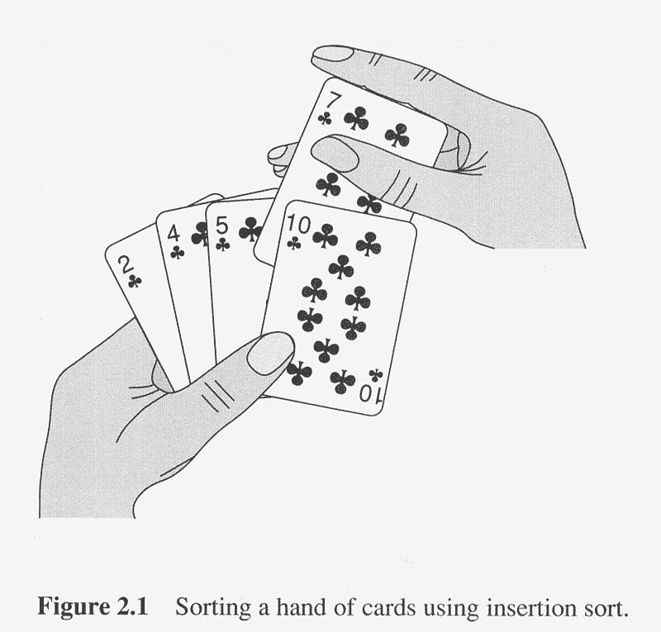
Insertion Sort

Slide 15
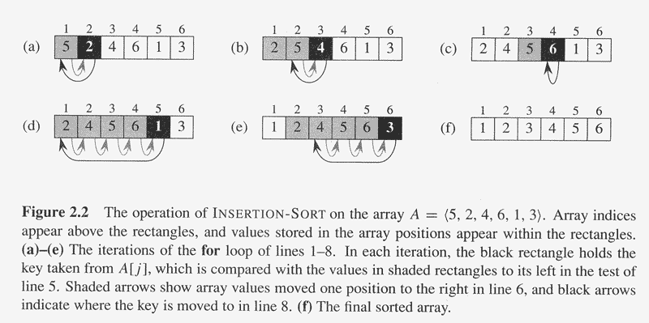
Insertion Sort

Slide 16
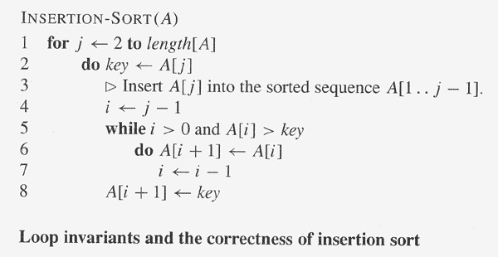
Insertion Sort

Slide 17
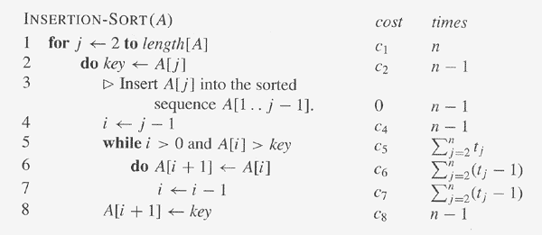
Insertion Sort

Slide 18
Selection Sort
Void Selection (Input Array A)
  int MinPos, temp, i, j;
  for(i = n-1; i > 0; i--)
    MinPos = i;
    for ( j = 0; j < i; j++)
      If ( A[ j ] < A[ MinPos ]) MinPos = j;
    Temp = A[ i ];
    A[ i ] = A[ MinPos ];
    A[ MinPos ] = temp;

